Slide 1

Exploratory Data Analysis
<Marketing Strategy>
<2023.1.20>

Slide 2
Agenda
Executive Summary
Problem Statement
Approach
EDA
EDA Summary
Model Suggestion

Slide 3
Executive Summary
Clean and preprocess the dataset for analysis
Analyze features and their associations with customer decision
Summarize the feature importance and suggest ML models

Slide 4
Problem Statement
This project aims to fix the problem that there are too many potential clients associate with a Portuguese banking institution. The bank marketing campaigns are primarily based on phone calls. However, there are too many potential clients, and it is impossible to call all of them. Hence, some machine learning techniques are needed to classify the customers and predict if they are going to subscribe the term deposit or not. By implementing ML models, we are able to limit the number of ‘potential clients’ to an acceptable number that make sure the marketing strategies can be carried on.

Slide 5
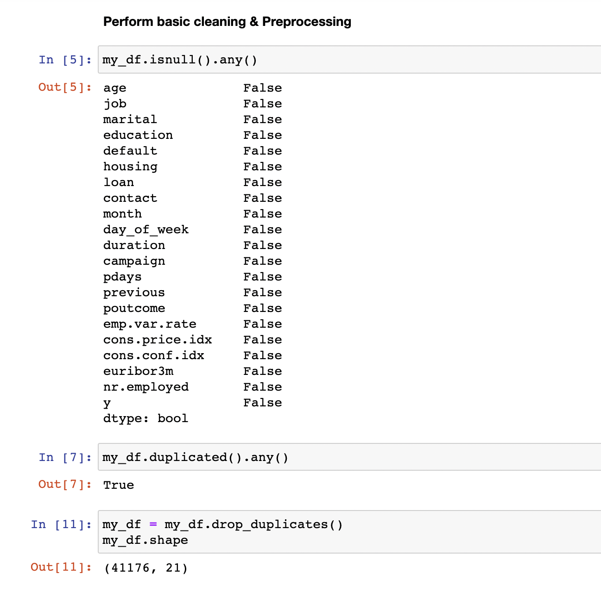
Approach
Data Loaded & Cleaning & Preprocessing

Slide 6
Approach
EDA analysis & Visualization using Tableau
Machine Learning Algorithms

Slide 7
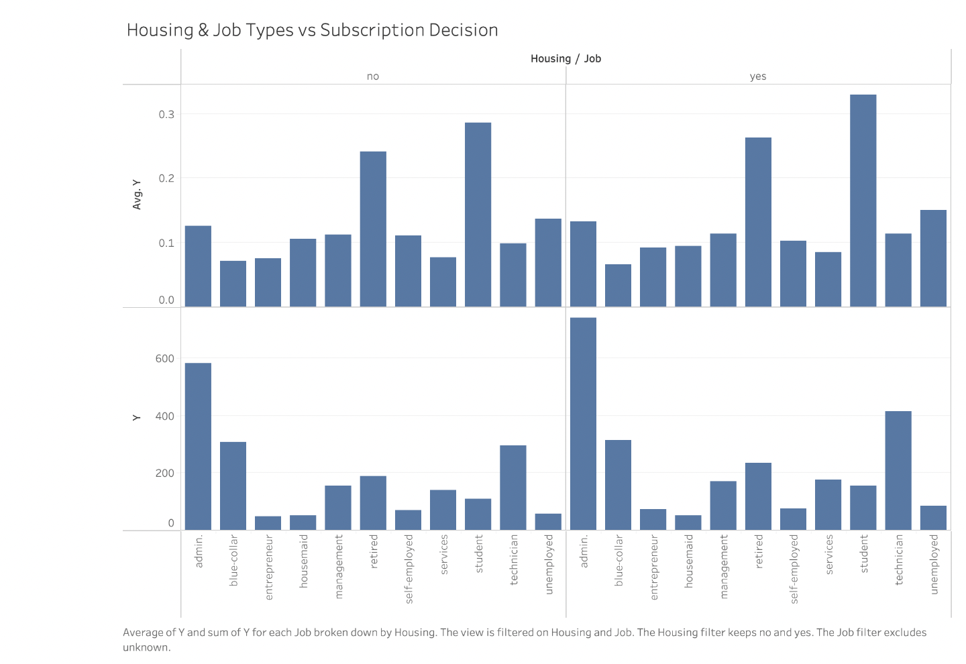
EDA
Housing & Job Types

Slide 8
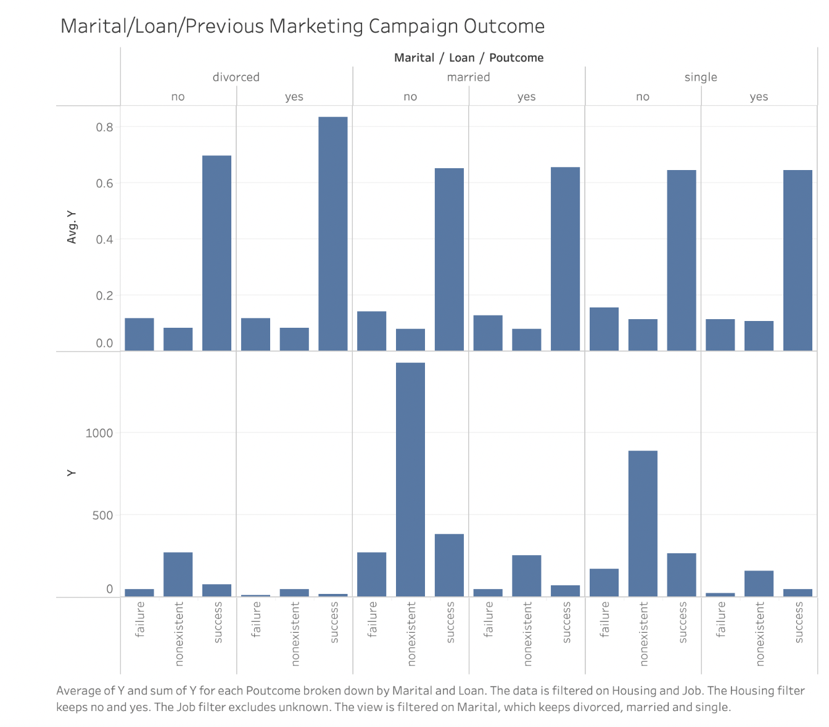
EDA
Marital & Loan &Previous Marketing Campaign
Marital does not have much effects
Clients have records of Previous Marketing Campaign have significantly higher outcome.

Slide 9
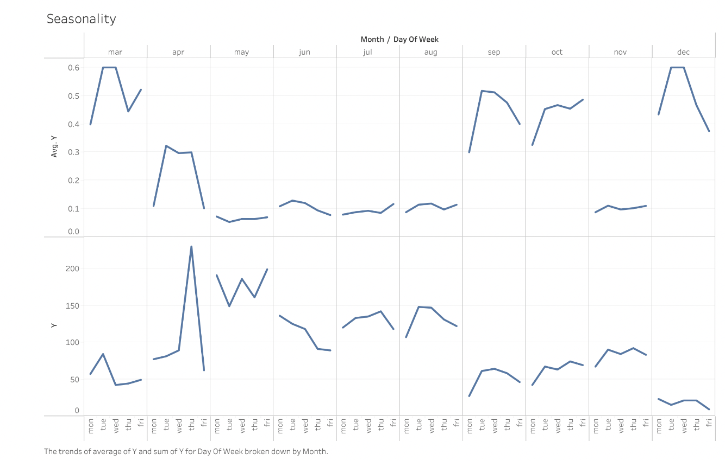
EDA
Seasonality
Peak: Dec – Mar
Low: May – Aug
No obvious weekly seasonal trends detected

Slide 10
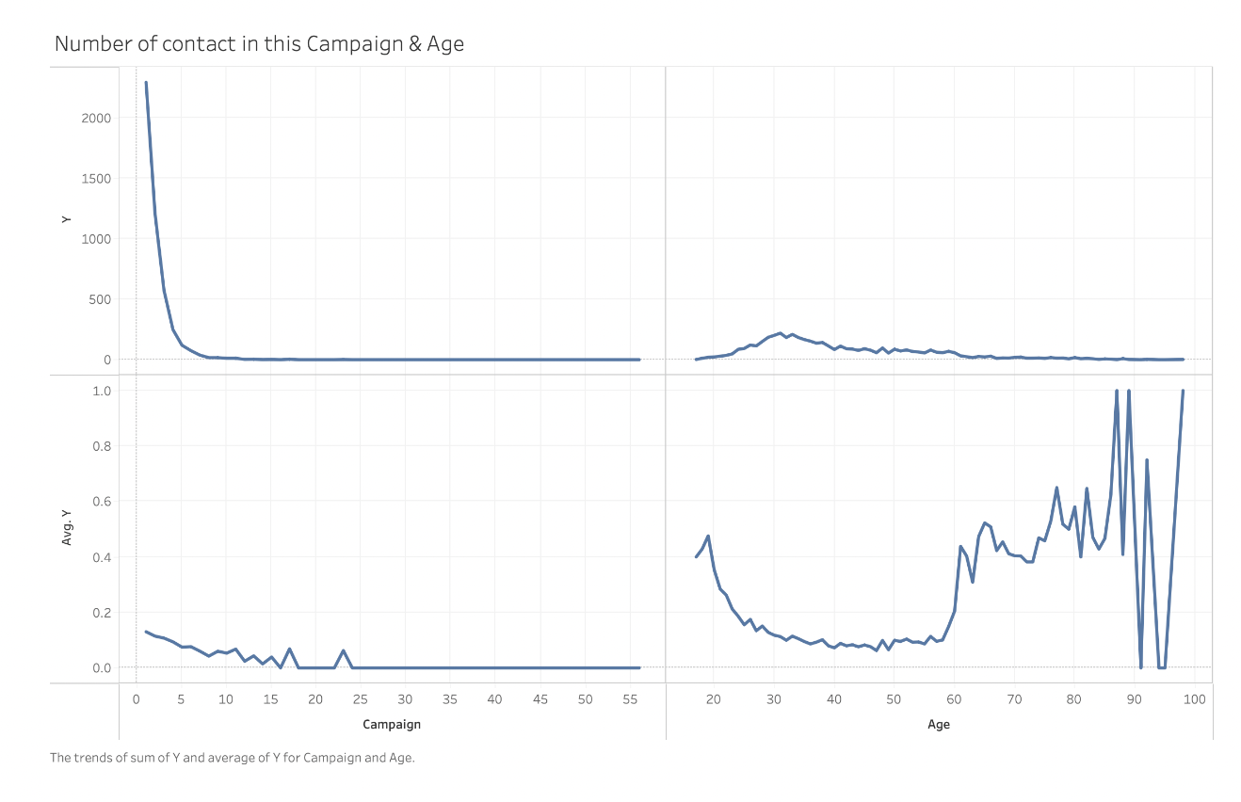
EDA
Number of Contact
The number of contacts are centered mostly at the range below 10
Age is uncertainty. The fluctuation is very big as age goes up.

Slide 11
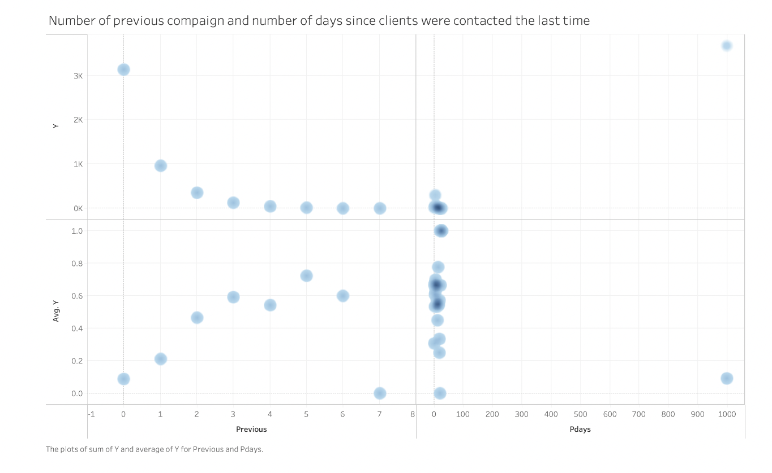
EDA
Number of days since last contact & previous contact
Number of previous contacts is most effective when p-days equal to 5.

Slide 12
EDA Summary
As above, we analyzed the features and their potential influence to the outcome subscription decision. We found that Number of contact in the current campaign, number of previous contact, job type, education have relatively stronger influence on the outcome decision, while some other feature could help us categorize customers and help us make strategies with respect to different group of customer.¶

Slide 13
ML Model Suggestion
Linear Model (LDA, Logistic Regression)
Bayesian Model (Naïve Bayes, Gaussian NB)
SVM (Linear SVM, SVM with different kernels)
KNN
Tree Based models (XGBoost, Random Forest, Extra Trees)
Neural Networks (Multi-Layer Perceptron)

Slide 14
Thank You

